Slide 1

Module two: Dev Sec basics
CIS 311 – Prof. C. R. Johnson

Slide 2
Secure Development Processes
CLASP (Comprehensive, Lightweight Application Security Process)
Correctness-by-Construction (formal methods based process from Praxis Critical Systems)
MS SDL (Microsoft Secure Development Lifecycle)
SSE CMM (Secure Software Engineering Capability Maturity Model)
TSP-Secure (Team Software Process for Secure Software Development)

Slide 3
Security Lifecycle
Code Reviews
Risk Analysis
Penetration Testing
Security Testing
Abuse Cases
Security Operations
Abuse Cases
Risk
Analysis
Code Reviews +
Static Analysis
Security
Testing
Penetration
Testing
Security
Operations
Requirements
Design
Coding
Testing
Maintenance

Slide 4
Code Reviews
Fix implementation bugs, not design flaws.
Benefits of code reviews
Find defects sooner in the lifecycle.
Find defects with less effort than testing.
Find different defects than testing.
Educate developers about security flaws.

Slide 5
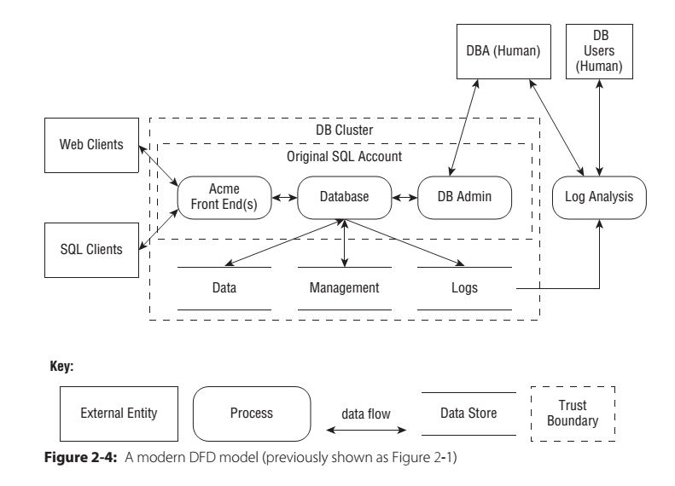
Architectural Risk Analysis

Slide 6
Black Box Testing
Advantages of Black Box Testing
Examines system as an outsider would.
Tester builds understanding of attack surface and system internals during test process.
Can use to evaluate effort required to attack system.
Helps test items that aren’t documented.
System
Test Input
Test Output

Slide 7
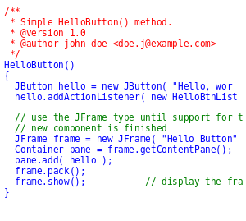
White and Grey Box Testing
White Box
Tester knows all information about system.
Including source code, design, requirements.
Most efficient technique.
Avoids security through obscurity.
Grey Box
Apply both white box and black box techniques.
Test Input
Test Output
Notes:
https://en.wikipedia.org/wiki/File:CodeCmmt002.svg

Slide 8
Penetration Testing
Black box test of deployed system.
Allocate time at end of development to test.
Often time-boxed: test for n days.
Schedule slips often reduce testing time.
Fixing flaws is expensive late in lifecycle.
Penetration testing tools
Test common vulnerability types against inputs.
Fuzzing: send random data to inputs.
Don’t understand application structure or purpose.

Slide 9
Security Testing
Functional testing will find missing functionality.
Injection flaws, buffer overflows, XSS, etc.
Intendended
Functionality
Actual
Functionality

Slide 10
Security Testing
Two types of testing
Functional: verify security mechanisms.
Adversarial: verify resistance to attacks generated during risk analysis.
Different from traditional penetration testing
White box.
Use risk analysis to build tests.
Measure security against risk model.

Slide 11
Abuse Cases
Anti-requirements
Think about what software should not do.
A use case from an adversary’s point of view.
Obtain Another User’s CC Data.
Alter Item Price.
Deny Service to Application.
Developing abuse cases
Informed brainstorming: attack patterns, risks.

Slide 12
Security Operations
User security notes
Software should be secure by default.
Enabling certain features may have risks.
User needs to be informed of security risks.
Incident response
What happens when a vulnerability is reported?
How do you communicate with users?
How do you send updates to users?

Slide 13
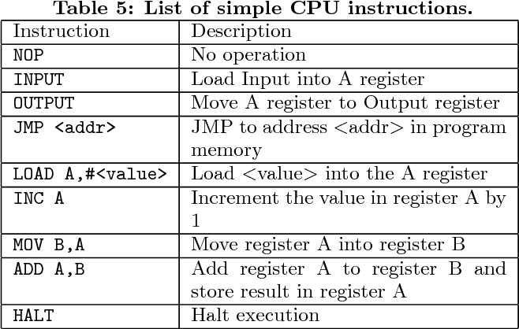
CPU REGISTER
Very short term and very small memory – 8 bits is a byte, 64-bit systems process 8 bytes at a time. So a 3.7GHz processor can process 8 byes 3.7 billion times / second.
Many kinds of registers for different things. Instruction register for pulling form RAM, address registers for seeking primary memory locations
CPU CACHE
L1 Cache
L2 Cache
RAM
Physical/Primary Memory
Virtual Memory
STORAGE DEVICE
HDD / SSD
Removable Drives
Connected Storage / Cloud storage
ROM / BIOS
ARCHIVAL STORAGE
Optical Media
Tape Media

Slide 14

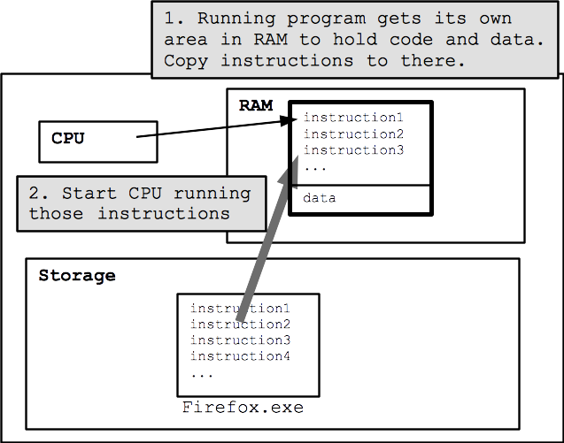

Slide 15

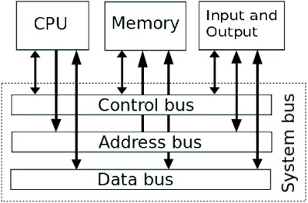

Slide 16
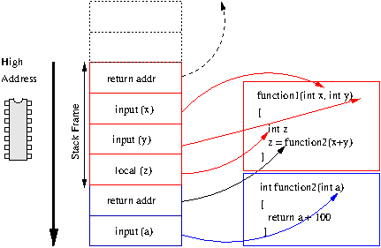

Slide 17
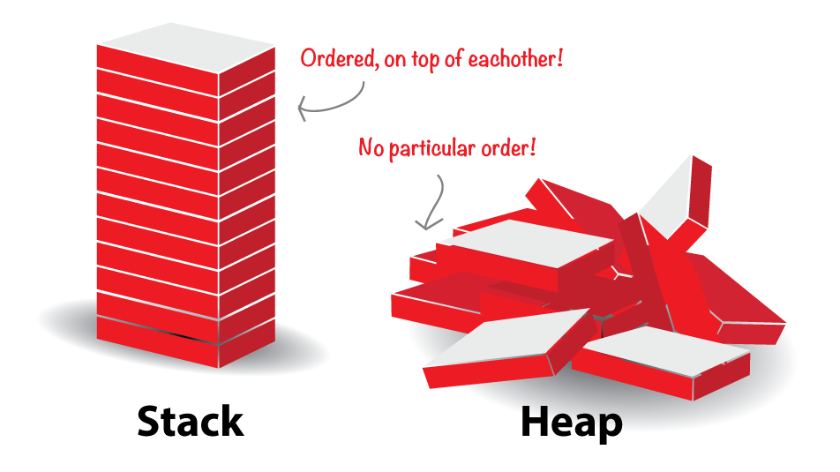

Slide 18
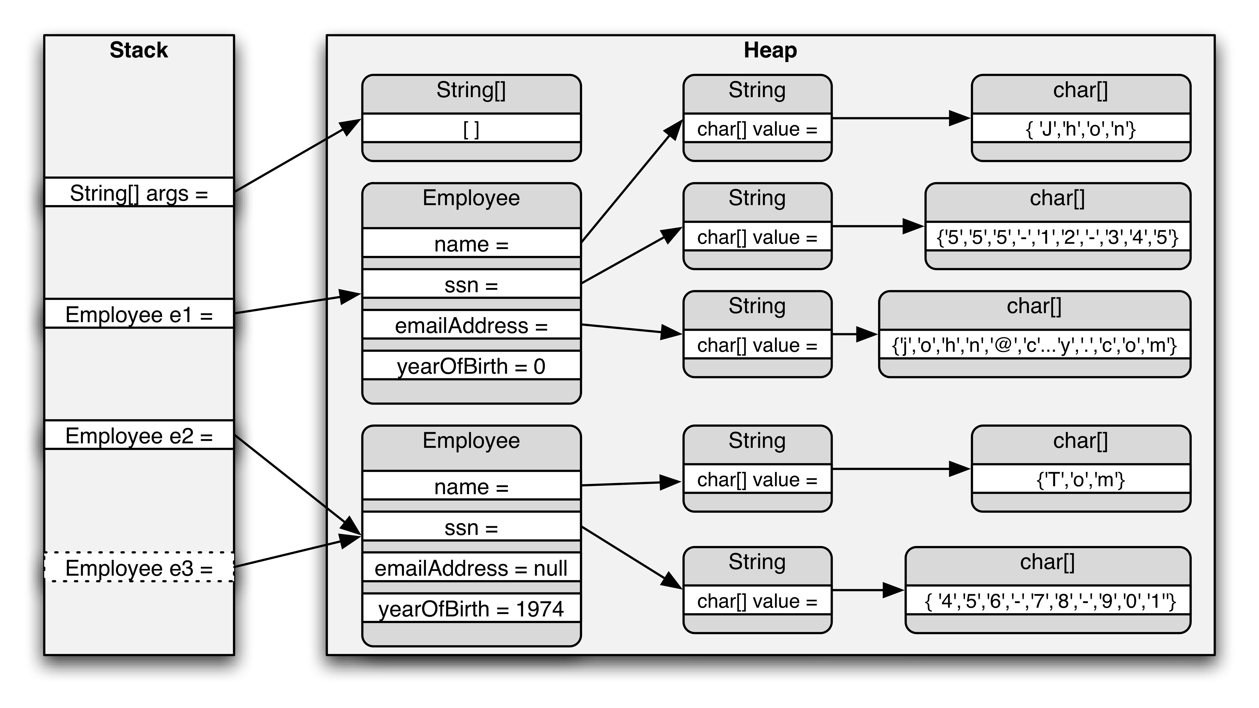

Slide 19
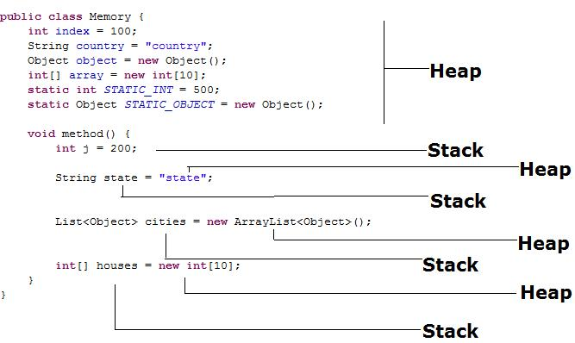

Slide 20
